Slide 1
American Social Welfare in Transition
The Path 50 Years Later

Slide 2
The historical path
Original FDR Welfare State: Social Security and Public Assistance
Government part of the solution
Active role
Conservative Culture Begins: Government not the solution but the problem
Reagan, Bush one and two, Clinton
Elements Affecting a Changing Ideology
Deficits from Bush II
Emergence of the Tea Party
Anti-Science attitude
Anti-government attitude increases
Mixed Welfare Economy
Government social welfare policy
Volunteer social welfare policy
Corporate social welfare policy

Slide 3
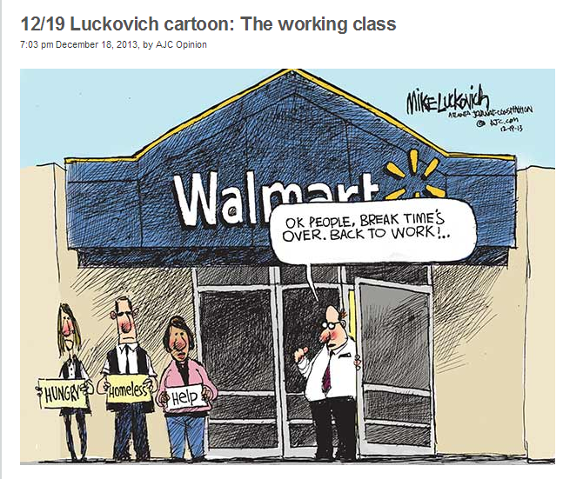
Values and ideology of today
Self sufficiency
Work
Omniscience of
the market

Slide 4
Economic continuum
Liberal
Conservative
Keynesian Economics
Macro Economic stabilization by government necessary
Good government is an activist government
Main principles of followers
Social equity
Interdependence
Mutual self interest
Milton Friedman
Father of modern conservative economics
Welfare spending had no economic benefit
Opportunity based on one’s relationship to the marketplace.
Main principles of followers
Maximize self interest
Public welfare erodes work ethic, takes taxes from the market

Slide 5
Political continuum
Liberalism
Conservatism
Libertarianism
Social Equity
Interdependence
Mutual Self Interest
Maximize self interest
Market
Traditionally economic conservatives
Little or no government regulation
Government growth at expense of individuals
The Tea Party
The combination of economic conservatives, social conservatives and libertarians

Slide 6
The birth of prwora
Neo-liberalism
Neo-Conservatism
More cautious about government
More favorable to big business
Skeptical about entitlements
Charles Peters
Democratic Leadership Council
Clinton/Gore
Glass Steagall story
Think Tanks
Need only philosophy of welfare
Eliminate fraud (welfare queens)
Fair, clear work requirements
Remove “inappropriate” recipients
Enforce dependent support
Improve efficienty
Shift from public to private sector
The Great Risk Shift

